Slide 1
Counselling HQ Website Content

Slide 2

Welcome to Counselling HQ Specialist Counselling & Psychotherapy for Children & Adults Natasha Hilton-Quick Integrative. Dip.Couns, MBACP A safe space to feel heard and understood
Face-to-face and online therapy for adults, young people & children
Whether you’re seeking support for yourself, your child, or a loved one, you’re in the right place.
If life feels harder than it should, or you’re not feeling yourself, counselling can help.
You might be feeling low, disconnected, overwhelmed, or self-critical and not yourself.
Maybe there’s been a significant event, your energy has dipped, or the things that once brought enjoyment no longer feel the same.
At Counselling HQ, you don’t need to have the answers before reaching out. This is a calm and confidential space to discuss things, feel understood, and move forward at your own pace. Where your experiences are taken seriously, and your voice is valued.
You’re welcome here — exactly as you are.
Get in touch via email link buttons
This is as far as I have got with my logo. Not sure about font

Slide 3

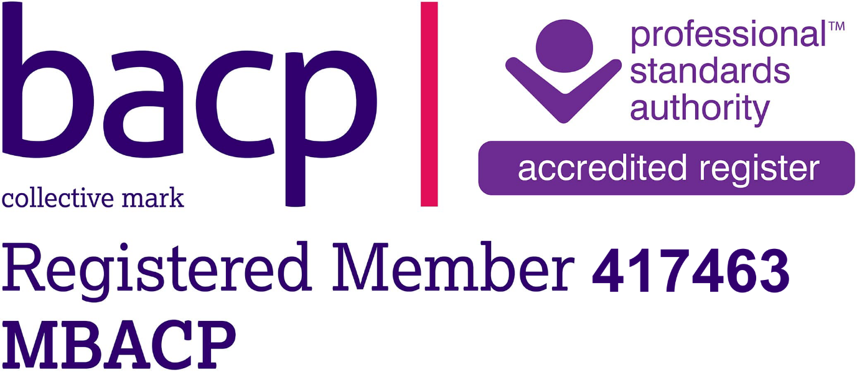
Meet Natasha
Possibly video
Hello, I’m Natasha — though most people call me Tasha.
Before training as a counsellor, I spent 24 years as a teacher, working in both private and public schools across Southeast Kent.
During that time, I supported children and young people aged 5–18 through academic pressure, emotional challenges, and major life changes.
I became a counsellor because I understand how it feels to be overwhelmed, dissatisfied, or unsure where to turn…even when everything looks fine on the outside. That lived experience strongly shapes how I work today.
I now work in schools and have a private practice working with children and adults, in short and long-term therapy.
I deeply believe in the quiet power of being truly listened to. Therapy doesn’t have to be about being “fixed”. Sometimes it’s about having someone alongside you, helping you slow down, make sense of what’s happening, and reconnect with your own inner resources.

Slide 4
Professional background
Completed Levels 2, 3 & 4 - Diplomas in Therapeutic Counselling CPCAB (Counselling and Psychotherapy Central Awarding Body)
Currently completing Level 5 Diploma in Psychotherapeutic Counselling (CPCAB) - July 2026
Registered Member of the BACP (British Association for Counselling and Psychotherapy)
Enhanced DBS Certificate
Full professional indemnity insurance
Extensive experience supporting neurodivergent children and adults, including autism, ADHD, sensory differences and emotional regulation challenges.
I work ethically, safely, and with your well-being at the centre of everything I do.

Slide 5
My Therapeutic Approach
My approach is integrative, holistic and person-centred.
This means I don’t try to fit you into one model of therapy. I work with you as a whole person, tailoring therapy to your unique experiences and needs.
I see you as the expert in your own life. My role is to offer a supportive, thoughtful space where we can explore your experiences together in a way that feels safe and manageable.
Depending on your needs, I may draw on different integrative models such as CBT tools, inner-child work, play therapy, creative, reflective or expressive methods.
As a trauma-informed, strengths-based practitioner, I believe that growth and change are possible when people feel safe, understood, and accepted. Therapy can help you build trust in yourself, understand old patterns, and feel more grounded and connected in your life.
These approaches are used collaboratively and gently, always at your pace.
As a trauma-informed, strengths-based practitioner, I believe that growth and change are possible when people feel safe, understood, and accepted. Therapy can help you build trust in yourself, understand old patterns, and feel more grounded and connected in your life.

Slide 6
Counselling for Adults & Young People
Life can feel heavy at times. You may be coping on the outside while struggling underneath, or facing a clear challenge such as grief, anxiety, relationship breakdown, or a major life transition.
In our sessions, I am fully present with you. We will explore what’s happening — both on the surface and beneath it, with care and compassion.
I support adults (male, female, non-binary) and young people with:
Anxiety, depression, stress, and burnout
Grief and bereavement
Divorce and relationship difficulties
Low self-esteem, co-dependency, people-pleasing
Communication challenges
Peri-menopause and identity shifts
Neurodiversity and emotional or sensory overwhelm
Unhelpful patterns such as avoidance, overthinking, or perfectionism
I am committed to offering an inclusive, affirming and culturally sensitive counselling space, where LGBTQIA+ identities are respected and where people of all backgrounds, cultures, abilities and lived experiences are welcomed.
If what you’re experiencing isn’t listed, you’re welcome to book a free 15-minute call to talk it through. If I’m not the right fit, I can help signpost you to appropriate support.
GET IN TOUCH BUTTON

Slide 7
Counselling for Children
Children experience big feelings just as deeply as adults, often without the words to explain them.
I offer a warm, steady space where children can express themselves in ways that feel natural to them. Depending on their age and needs, this may include play, creativity, stories, art, movement, or simple conversation.
I have particular experience supporting neurodivergent children, including those with autism, ADHD, sensory differences, and emotional regulation difficulties.
I support children with:
Anxiety and worry
Low mood or withdrawal
Friendship and school challenges
Loss and bereavement
Emotional regulation
Feeling different or struggling to fit in
Family changes such as separation or divorce
OCD, intrusive thoughts, self-harm or suicidal thoughts
Over time, children often gain a better understanding of themselves, feel more secure, and develop tools to manage their emotions with confidence.
If you or your child needs support with something not listed, you’re welcome to book a free 15-minute call. I can signpost you if I’m not the right fit. GET IN TOUCH BUTTON

Slide 8
How therapy can support change
As our work unfolds, you may start to notice small but meaningful changes, such as: – Thoughts and feelings that once felt confusing becoming a little clearer – A kinder inner voice, with less self-criticism and more self-understanding – Greater awareness of emotional patterns and relationship dynamics – Clearer boundaries and a stronger sense of what you need – Subtle shifts in how you relate to yourself and others – A growing sense of steadiness, clarity, and emotional breathing space
Change doesn’t need to be dramatic to matter. Often, it shows up quietly in everyday moments.

Slide 9
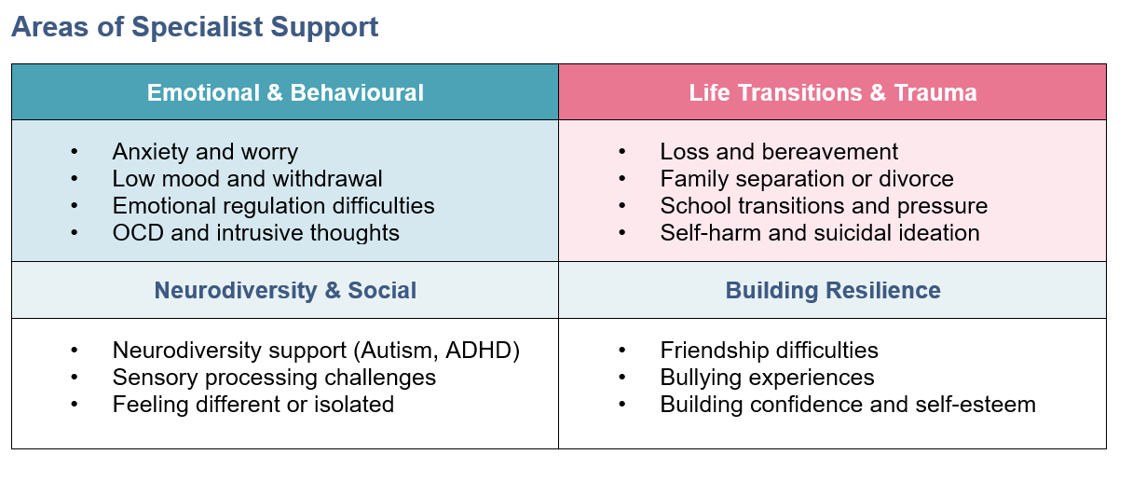
Areas of Specialism

Slide 10

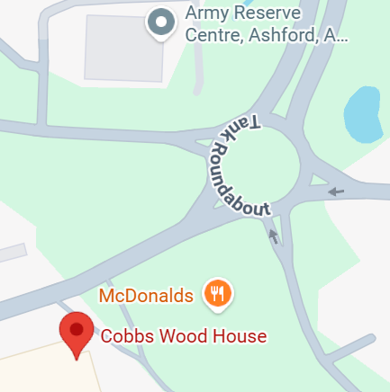
Location & Sessions
Face-to-face sessions take place in my private counselling room at:
Cobbs Wood House, Chart Road Ashford, Kent TN23 1EP
Online video and telephone sessions are also available.
Map:
Parking is available on site and there is a waiting room for parents or family members.
Get in touch via email link buttons
Email: tashacounsellinghq@gmail.com
I aim to respond to emails within 48 hours. If you need urgent support, please contact emergency services. Details of additional support can be found on my signposting page.
Can the map have a link with Google maps? directions?

Slide 11
Begin Your Counselling HQ Journey
Taking the first step towards supporting you or your family members' emotional well-being is an act of profound care.
There’s no pressure to perform or have the “right” words here.
You can show up feeling unsure, overwhelmed, quiet, or confused — all of you is welcome.
If you’d like to explore working together, I offer a free 15-minute introductory call.
If I’m not the right fit, I can help signpost you to someone who may be.
GET IN TOUCH BUTTON

Slide 12
Professional Fees
Sessions are £65 per therapeutic hour (50 minutes), or £180 when booked as a block of three or more.
Concessions available for low-waged earners and for student counsellors.
I usually recommend a minimum of six sessions, so we have time to build a trusting relationship and achieve meaningful progress. Payment is accepted via bank transfer or cash prior to each session.
Ultimately, you choose what feels right for you. There is no expectation.
Payment for sessions will be expected via cash or bank transfer before each session.
Get in touch via email link buttons
linked to tashacounsellinghq@gmail.com

Slide 13
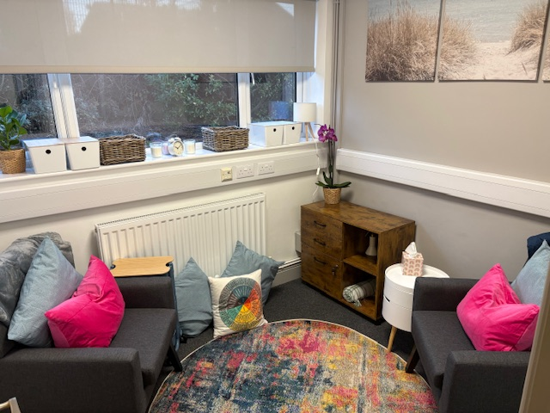
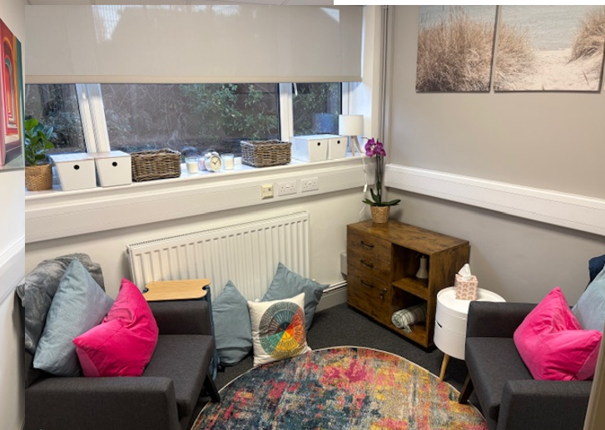
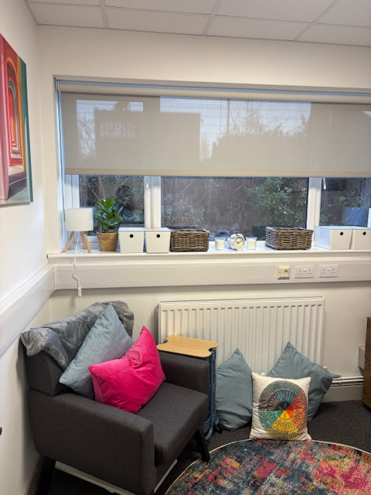
My Therapy Room: Need better photos & Photos of me in the room

Slide 14
Policies & Ethics
Cancellation Policy:
If you need to cancel or reschedule a session, please give at least 24 hours' notice.
Sessions cancelled with less than 24 hours’ notice will still be charged.
I understand that unexpected situations and emergencies happen. If this is the case, please do let me know and I will do my best to be flexible where possible.
Ethical and professional principles:
As a member of the BACP (British Association for Counselling and Psychotherapy) this means that I commit to high ethical standards, ongoing training (CPD), and supervision, offering you a trusted quality mark. You can have assurance that as your therapist I have to meet rigorous UK standards for competence and safety through the public BACP Register. This provides me with a professional and ethical framework to keep you safe. And it protects you from unqualified practitioners, ensuring ethical conduct.
For further details: https://www.bacp.co.uk/about-us/about-bacp/
Diversity statement:
I am committed to offering a welcoming, inclusive space where you are respected and valued for who you are. I work with people of all backgrounds, identities, cultures, abilities, and lived experiences, and I approach our work together with openness, curiosity, and compassion. Diversity is recognised, celebrated, and held with care within my practice.

Slide 15
Signosting
Please note that Counselling HQ is not an emergency service.
If you are in crisis or need immediate support, please contact:
IN CRISIS:
Contact your GP
Emergency services – dial 999 if in immediate danger
If you aren't sure if you should call 999, you can call NHS 111 for advice. Call 111 (England and Wales) or contact NHS 111 online (England only). They will tell you what to do and where to go. Option 2
Samaritans – 116 123 (free, 24/7) https://www.samaritans.org/
Emergency services – dial 999 if in immediate danger
Shout – Text “SHOUT” to 85258 (24/7 mental health support) https://giveusashout.org/
National Domestic Abuse Helpline – Call 0808 2000 247 https://www.nationaldahelpline.org.uk/
DEBT & FINANCIAL HELP:
Identify Your Need: Are you struggling with debt, food, bills, or just need general guidance?
Use a Key Service: Start with MoneyHelper, StepChange or Citizens Advice to get an overview and links to specialists.
Check Local Resources: Contact your local council, find a local food bank and use online tools like Turn2us.

Slide 16
FAQ’s
What happens in a counselling session? We talk about whatever feels important to you. There’s no script or pressure, just a safe space to explore thoughts, feelings, experiences, behaviours and patterns at your pace.
What will happen in our free introductory call? The free introductory call is a chance to talk through what’s brought you to counselling and what support you are looking for. You’re welcome to ask any questions you may have. If you wish to proceed with therapy, I will email you a short questionnaire and our counselling agreement, so expectations and confidentiality are clear.
What will happen in the first session? In the first session, whether by phone, online, or in person, we will take time to get to know each other. You are welcome to ask any questions and get a sense of whether I feel like the right fit for you.
The first session will be a little different as I will complete an assessment. We will talk about what has brought you to counselling, a little about your background, and what you hope to gain from our work together. We’ll also go through our counselling agreement, so expectations, boundaries, and confidentiality are clear. We will discuss your questionnaire so I can understand and have a clear idea of what you want, need and how we can tailor our work to achieve your goals.
There is no pressure or obligation to continue. This first session is simply a chance for us to explore whether working together feels right for you.
How many sessions will I need? The number of sessions varies for each individual. Some people come for a short time (6-12 sessions), while others choose longer-term support. We will regularly review your goals together as we progress and go at a pace that suits you.
Can I end counselling at any time? Yes, you are free to end our counselling whenever you feel ready. Where possible, it is advised that we plan an ending session together, which brings our work to a gentle close.
How often will the sessions occur? Weekly sessions often work best, or fortnightly if this is your preference. Regularly meeting supports continuity and depth in our work together. We will arrange what suits you best depending on your wants, needs and life challenges.
When and how do I pay for sessions? Payment for sessions will be expected via cash or bank transfer before each session.
Is what I share completely confidential? Everything you share in counselling is treated with care and kept confidential. There are a few rare situations where I may need to share information, such as if there is a serious risk of harm to you or someone else, concerns about the safety of a child or vulnerable adult, or where the law requires it (for example, in relation to terrorism, money laundering, or a court order). Wherever possible, this would always be discussed with you first.

Slide 17
What are your qualifications?
I am a qualified teacher with a Bachelor of Science (Honours) degree and a Postgraduate Certificate in Education. I have extensive experience working in school settings with children and young people aged 7–18.
I later trained as a counsellor, completing Levels 2, 3, and 4 diplomas in Therapeutic Counselling (CPCAB). I am currently completing a Level 5 diploma in Psychotherapeutic Counselling (CPCAB).
I am a registered member of the BACP British Association of Counsellors and Psychotherapy, which provides me with an ethical and professional framework. The ICO Information Commissioner's Office, which upholds information rights in the public interest and ensures I am GDPR (General Data Protection Regulation) compliant this gives you more control over your personal data.
What therapy, supervision and training do you participate in?
During my five years of training, I have had weekly or fortnightly therapy myself and I continue to do so. I believe that continued personal therapy is still a vital part of being self-aware, ethical and professional.
I have a supervisor whom I meet fortnightly to discuss my client work. Names of my clients are kept anonymous, but this professional obligation ensures that I am managing my clients in a professional, ethical and suitable manner.
I regularly complete training and continuing professional development (CPD). This ensures that I stay informed, updated and continue to develop my knowledge and skills.
What’s the difference between counselling and psychotherapy?
Often these terms are used interchangeably; however, they can differ in focus and depth.
Counselling tends to focus on specific issues in the present. Psychotherapy is deeper and often longer-term, exploring underlying patterns, past experiences and how they shape you now.
Counselling typically involves a shorter-term focus on specific, current issues and providing immediate coping strategies, while psychotherapy is a deeper, longer-term process that addresses underlying causes of emotional and psychological difficulties by exploring past experiences and unconscious patterns. Psychotherapy can be more intensive, whereas counselling is often more focused on the "here-and-now" challenges, like a specific life event or relationship problem.

Slide 18
What’s the difference between counselling and coaching?
Coaching is great when you’re feeling generally okay but want support moving forward — setting goals, gaining motivation, and making changes in your life or work. It’s focused on where you want to be next.
Counselling is different. It offers a safe space to talk through difficult emotions, past experiences, or challenges that feel overwhelming right now. It helps you make sense of what you’re going through, build coping skills, and feel more like yourself again. Counselling is provided by trained and regulated professionals who support mental and emotional well-being.
A simple way to think about it: * Coaching supports growth and direction. * Counselling supports healing and understanding.
If you’re unsure which you need, I’m happy to help you explore the best option for you.
What is integrative therapy?
Integrative psychotherapy is a flexible approach tailored to the individual client. We are all unique, and so your therapeutic journey needs to be specific to you. Following our assessment, we will build a custom-built toolbox for your mind. This will blend techniques from different therapy styles. This is a whole-person approach that sees you more than just your symptoms, focusing on your mental, physical, and emotional well-being to help you become more whole and resilient
For more in-depth information: https://www.bacp.co.uk/about-therapy/types-of-therapy/integrative-counselling/
What is person-centred counselling?
Person-centred or Humanistic counselling is a collaborative approach that places you at the heart of the therapeutic process. I offer a warm, non-judgemental space where you are listened to with care, empathy, and respect, without pressure to be fixed or directed. I believe that, with the right support and understanding, people have the capacity to grow, heal, and find their own way forward.
You are the expert in your own life. My role is to understand your experiences from your point of view and to offer a supportive, reflective space. A sounding board where you can explore what you need, build insight, and move towards greater confidence, choice, and empowerment.
For an in-depth explanation: https://www.bacp.co.uk/about-therapy/types-of-therapy/person-centred-counselling/
What is Trauma-Informed & Strengths-Based therapy?
This philosophy offers a gentle, non-judgemental approach that focuses on your inner world and trusts your natural capacity to grow when you feel heard, valued, and understood. My work is trauma-informed, recognising the impact of life experiences and shifting the focus from “what’s wrong with you?” to “what’s happened to you?”
I work with sensitivity, safety, and collaboration. I won’t rush you or push you into anything before you’re ready. Instead, I walk alongside you, supporting you to explore what matters most at a pace that feels manageable, respectful, and empowering.
For an in-depth explanation: https://counsellingtutor.com/trauma-informed-practice/what-is-trauma-informed-practice/

Slide 19
What is Cognitive Behaviour Therapy (CBT)?
CBT helps you understand how your thoughts, feelings, body and behaviours link together. It gives you practical tools to break unhelpful cycles and feel more in control.
Sometimes we get stuck in patterns that feel helpful in the moment but actually keep us feeling low, anxious or overwhelmed.
Together, we’ll look at what’s keeping those cycles going and build tools that help you break free of them. CBT focuses on the here and now and gives you strategies you can use in everyday life, so you can feel more in control and able to move forward.
For an in-depth explanation: https://www.bacp.co.uk/about-therapy/types-of-therapy/cognitive-behavioural-therapy/
What is Internal Family Systems (IFS)?
IFS explores the different “parts” of you. Perhaps there is an anxious part, a protective part, an overwhelmed part. Exploring these parts of you helps bring more harmony and self-compassion to your inner world.
For further information: https://internalfamilysystemstraining.co.uk/

Slide 20
What is inner-child therapy?
Inner-child therapy focuses on understanding and caring for parts of you shaped by early experiences. It can help heal old emotional wounds, build self-compassion and change long-standing patterns.
Learn more: https://ifs-institute.com/resources/articles/inner-child-work
What is play therapy?
Play therapy helps children express feelings and experiences through play rather than words alone. It provides a safe, supportive space where children can explore emotions, build confidence and develop coping skills.
Learn more: https://www.bapt.info/play-therapy/

Slide 21


Certificates and Badges
BACP Quality mark
https://www.bacp.co.uk/media/21191/psa-quality-mark-logo-for-online.png
For photo frame
https://www.bacp.co.uk/media/21201/psa-photo-frame-overlay-with-quality-mark.png
Instagram: CounsellingHQ
Linkedln:
Facebook:

